Slide 1


Booking Flight database project
Prepared by: Mircea Andrei Pomacu
Robert Cristian Draghici
Ionut Gabriel Buzduga
Organization: University of Craiova,
Faculty of Automation, Computers and Electronics

Slide 2

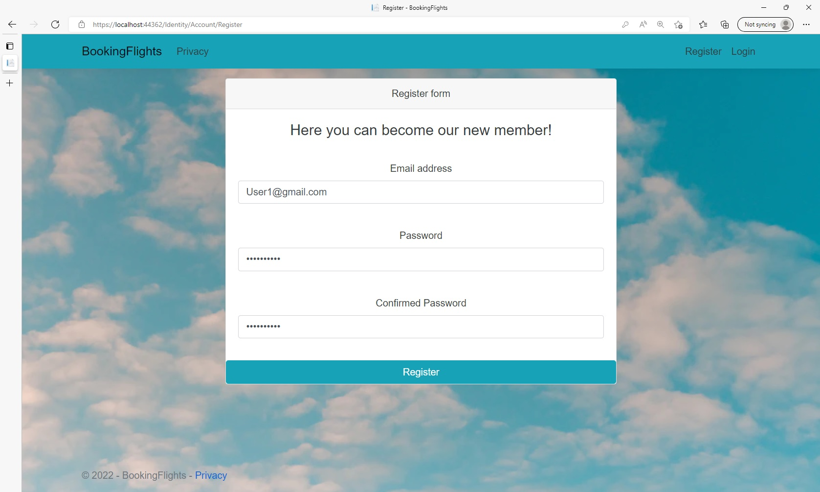
After the user introduces his email and password, he needs to click register in order to create his account

Slide 3
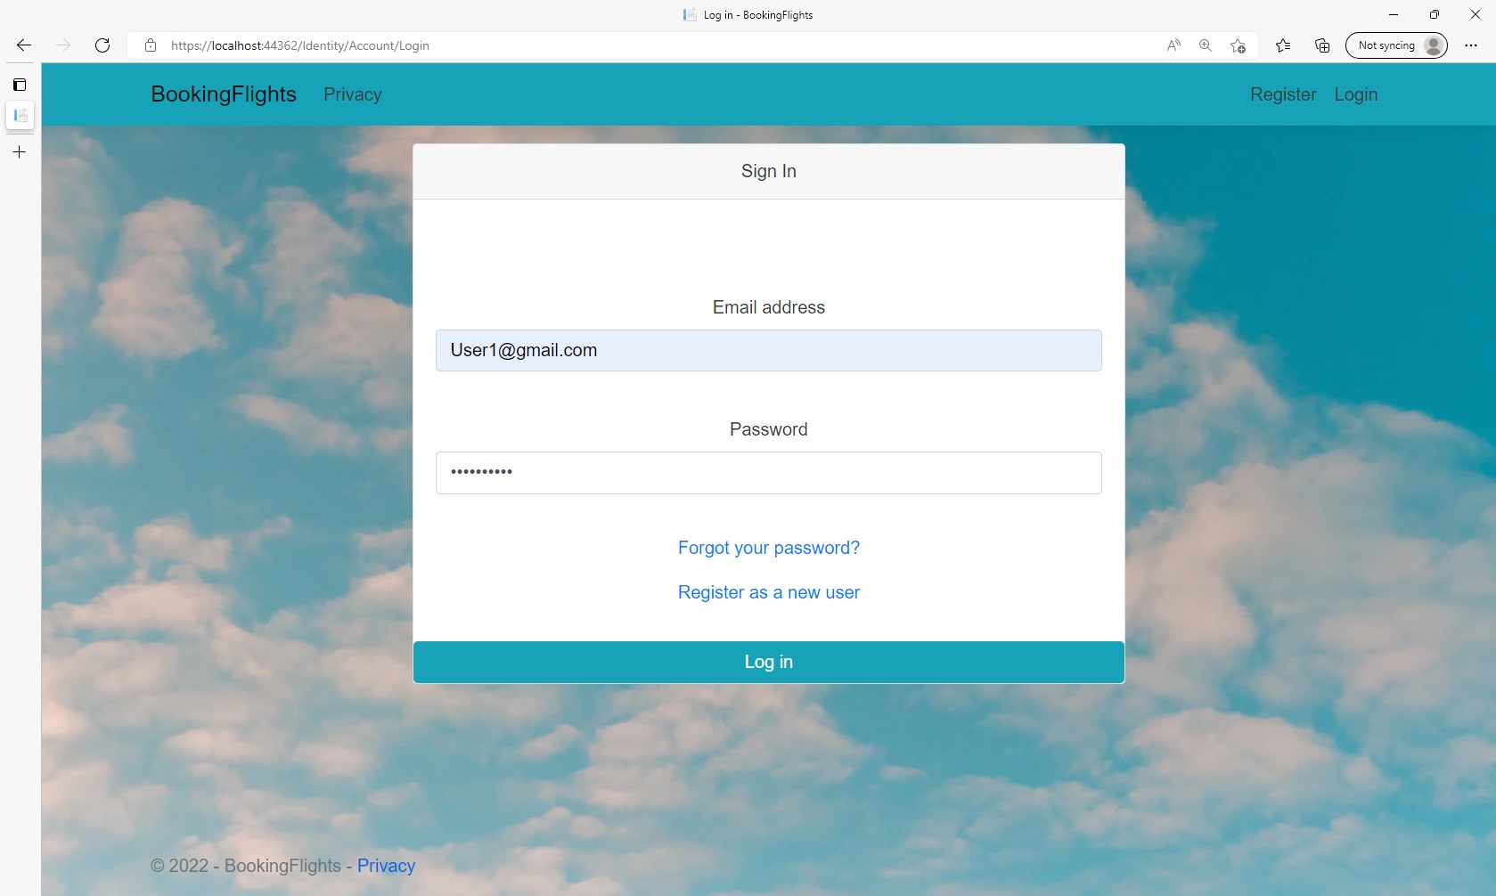
After registering, the user needs to access the log-in page and then enter his credentials

Slide 4

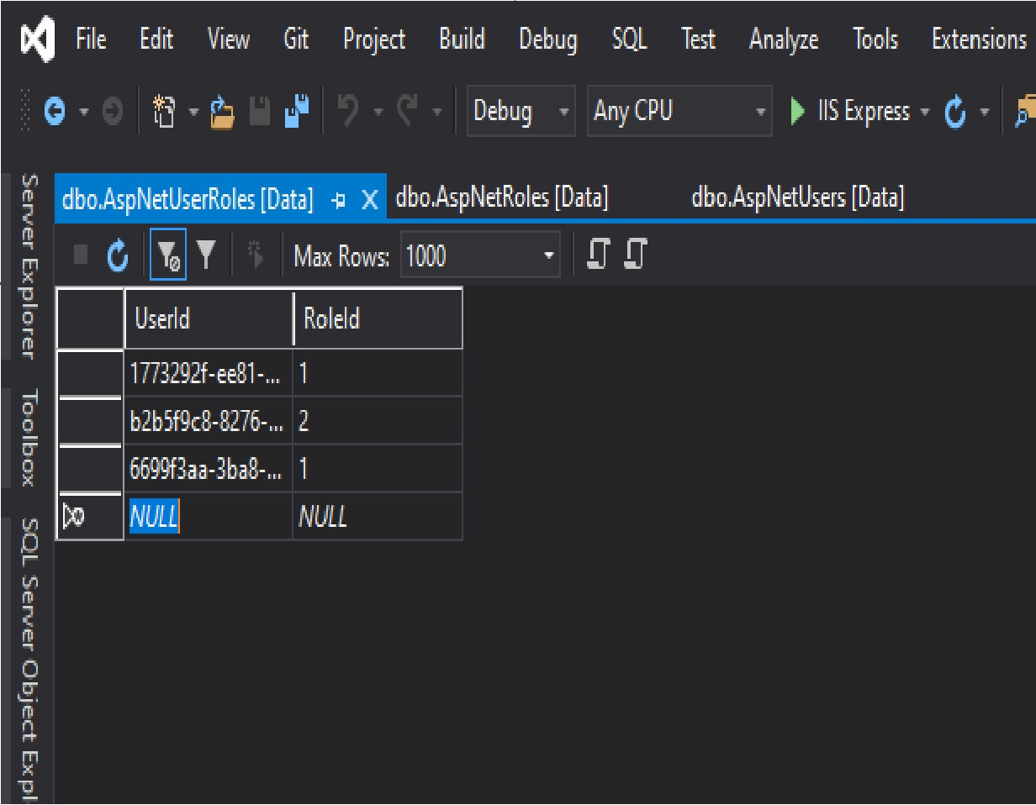

After that, one of the database administrators manually assigns one of the Roles(1 for User, 2 for Admin) to the new account

Slide 5
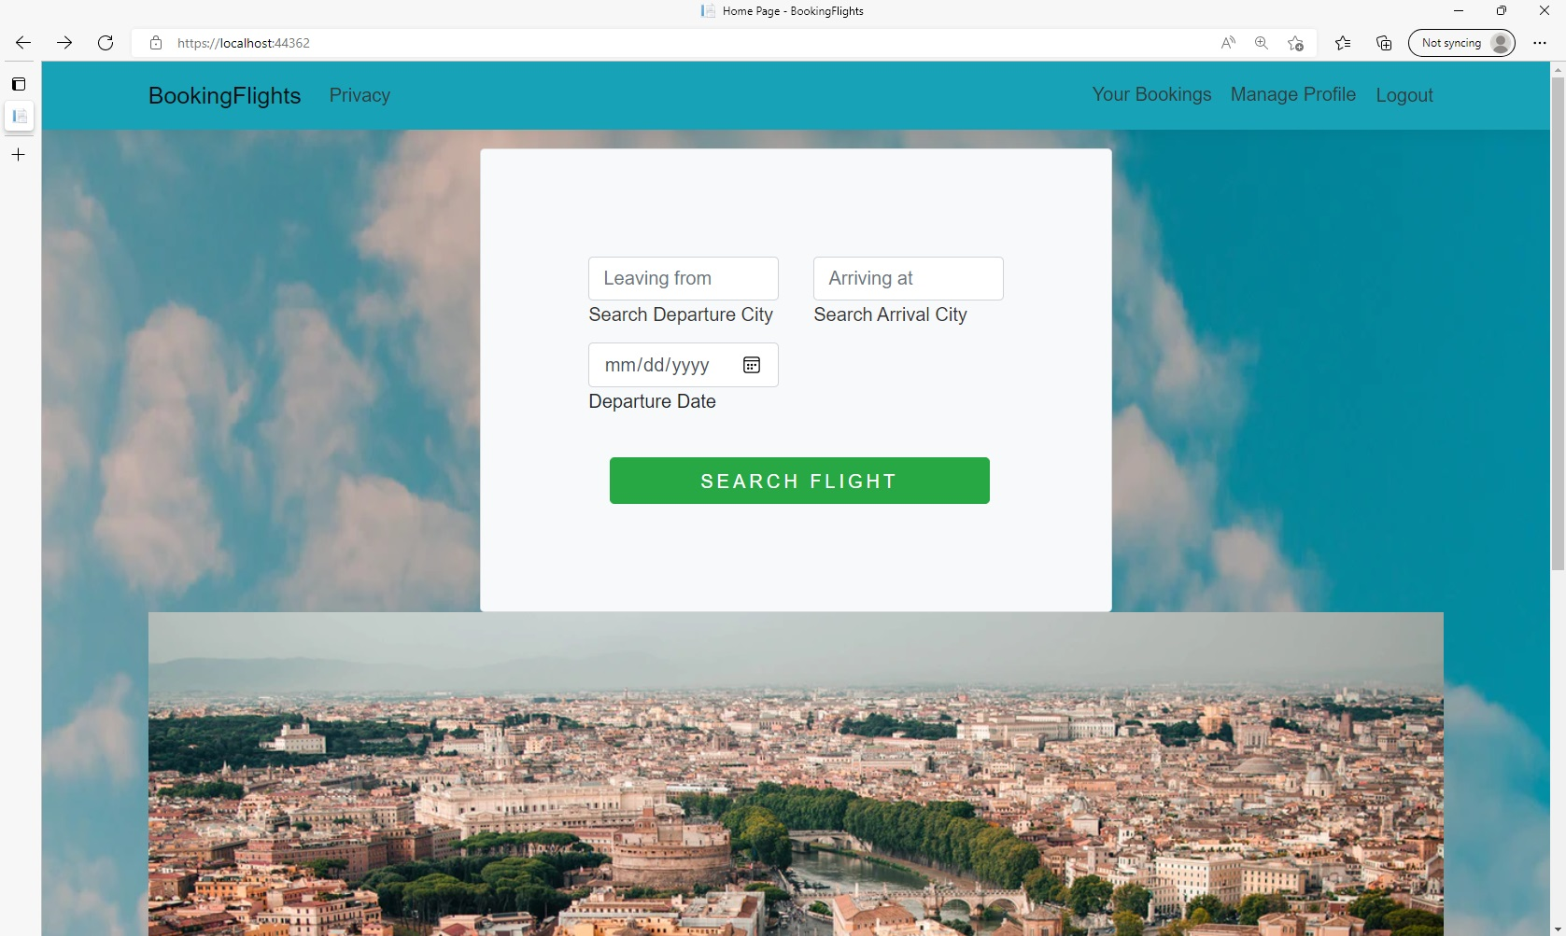
This is how the home page
Looks for a logged-in user
At the bottom of the page
There is an automatic
Slide show with touristic
locations

Slide 6
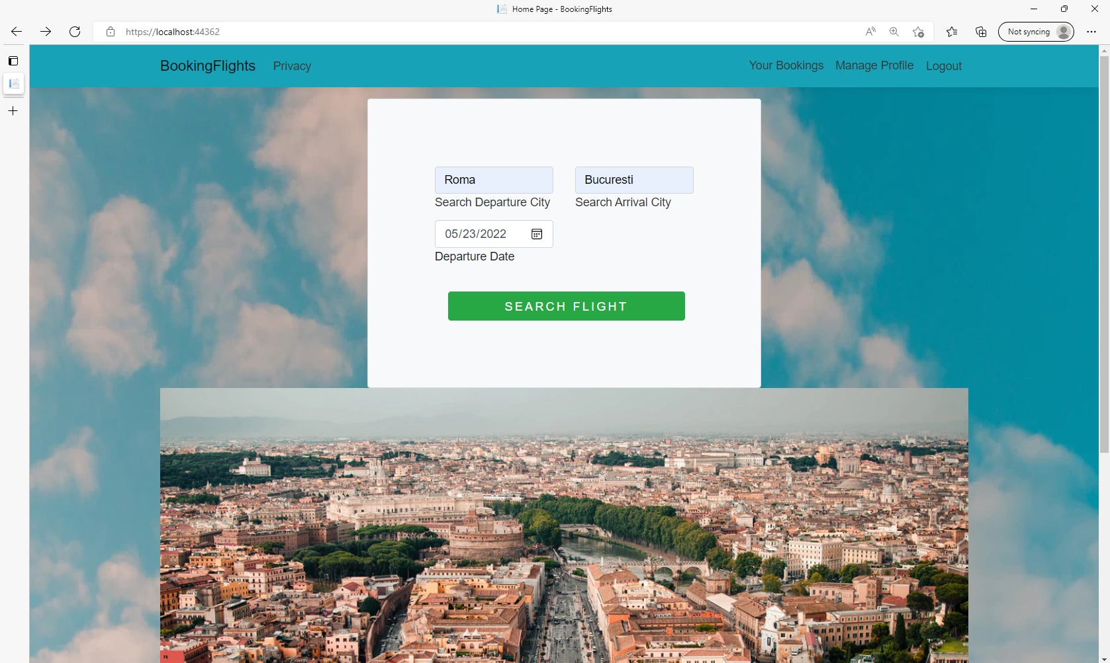
After the user enter the desired
Flight details he can search
For the respective flight

Slide 7
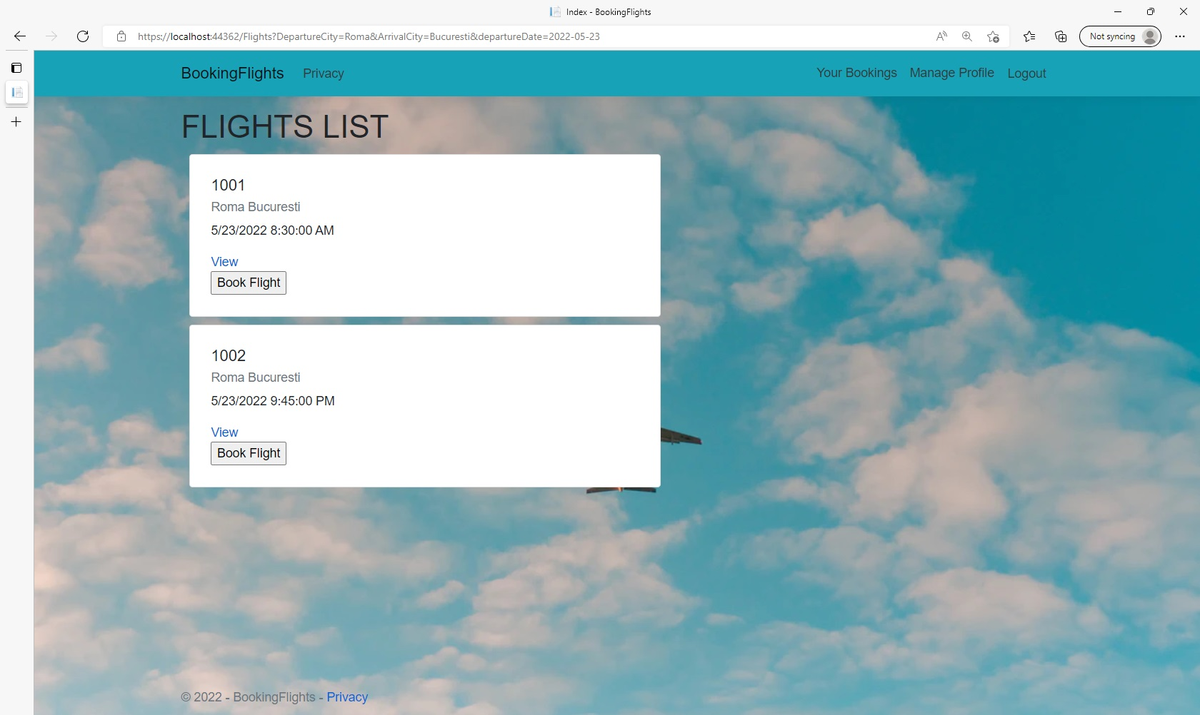
-A list of flights With the Departure and
Arrival Location chosen will be displayed
-All the flights with the respective date
Will be displayed even if they have different
Departure Hours
The book Flight Button Will send the user
To the ticket selection page

Slide 8
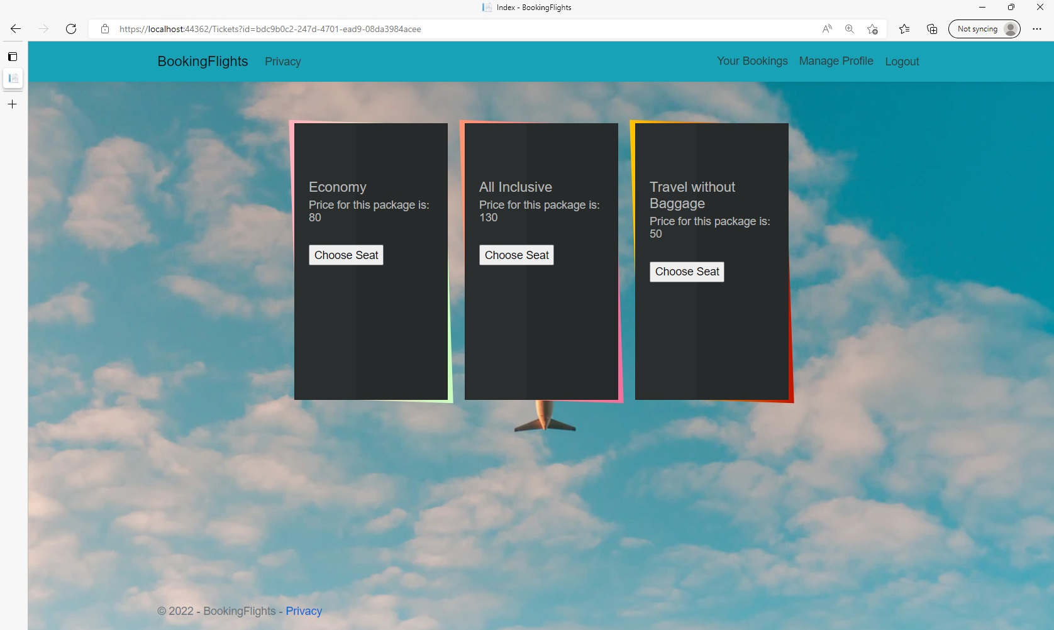
The user can select between the three types of tickets for the respective flight and then they will
Be sent to the Seat selection page.

Slide 9
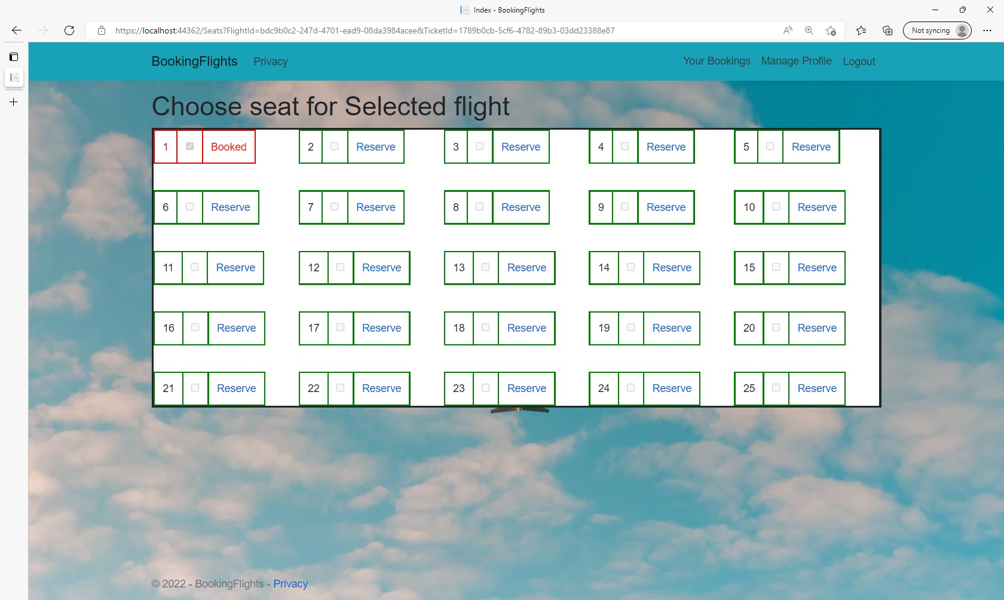
In the seat Selection page, the booked seats will be displayed with a red border, and the available
Ones with green borders.
After clicking the reserve button, the user will be sent to a page in which he can confirm his choice.

Slide 10
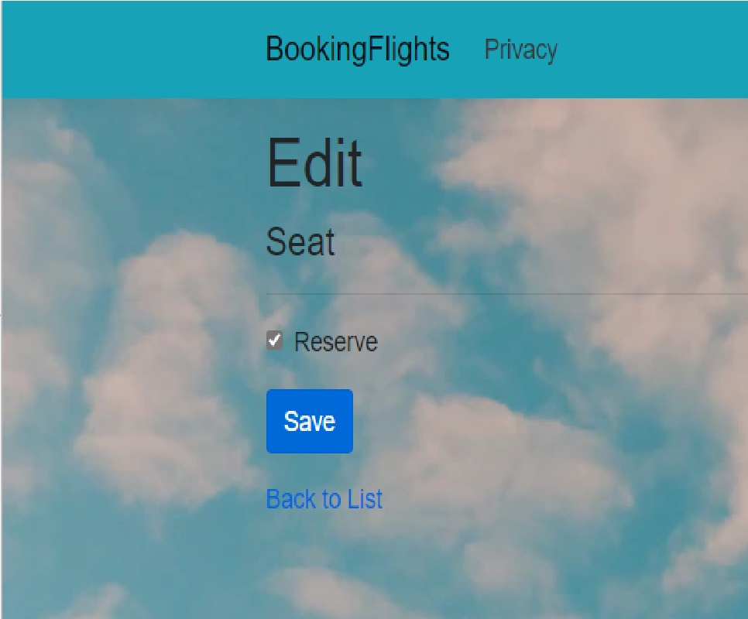
Here we can check the Reserve box and save our selection and thus complete the entire booking process.
Otherwise, we can go back to the List of Seats without finishing the booking.

Slide 11
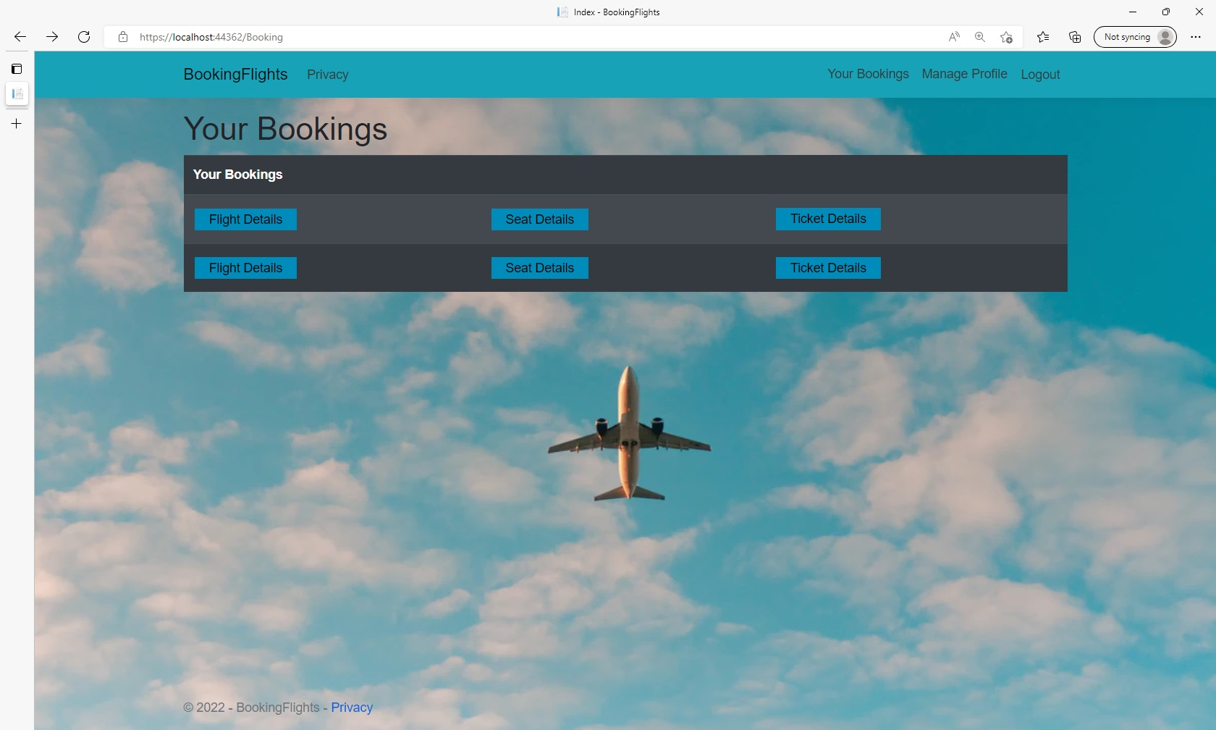
Here the user can see that his newly booked flight was successfully recorded along with other
Booked flights made before.
Each details button will give the respective information about the Flight, Seat, or ticket.

Slide 12
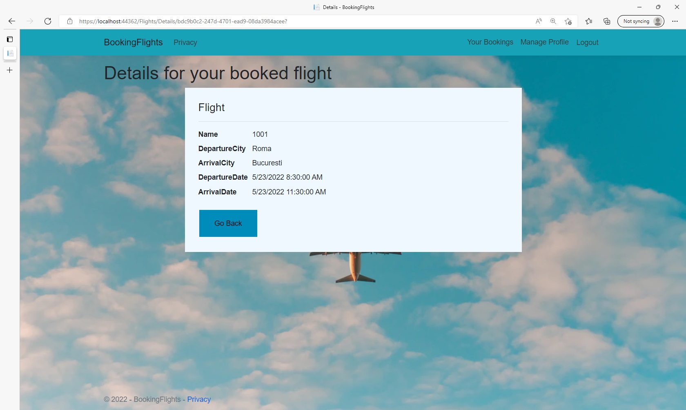
Finally, the user can see that the booked flight was correctly made and after that he can click
The Go Back button to see other bookings, or go directly into the home page by clicking the
BookingFlights button from the NavBar

Slide 13
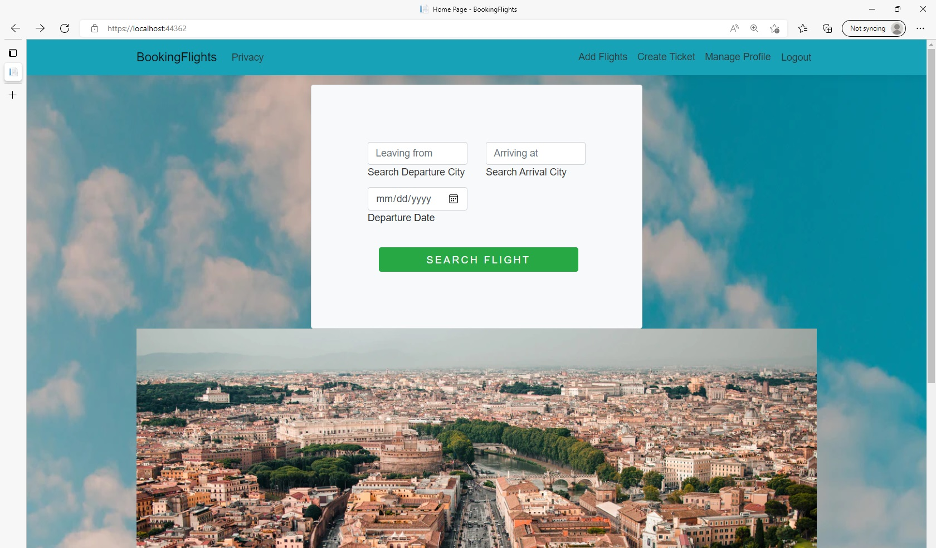
While being logged in as an
Administrator , you will have
Different options on the home
Page to either manage flight
Or ticket creation.

Slide 14
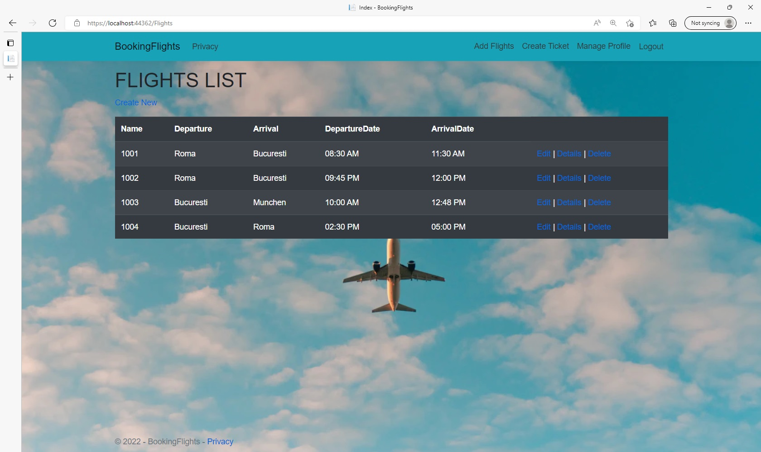
Button to create a new flight
Here the administrator has all the CRUD operations to manage the Flights

Slide 15
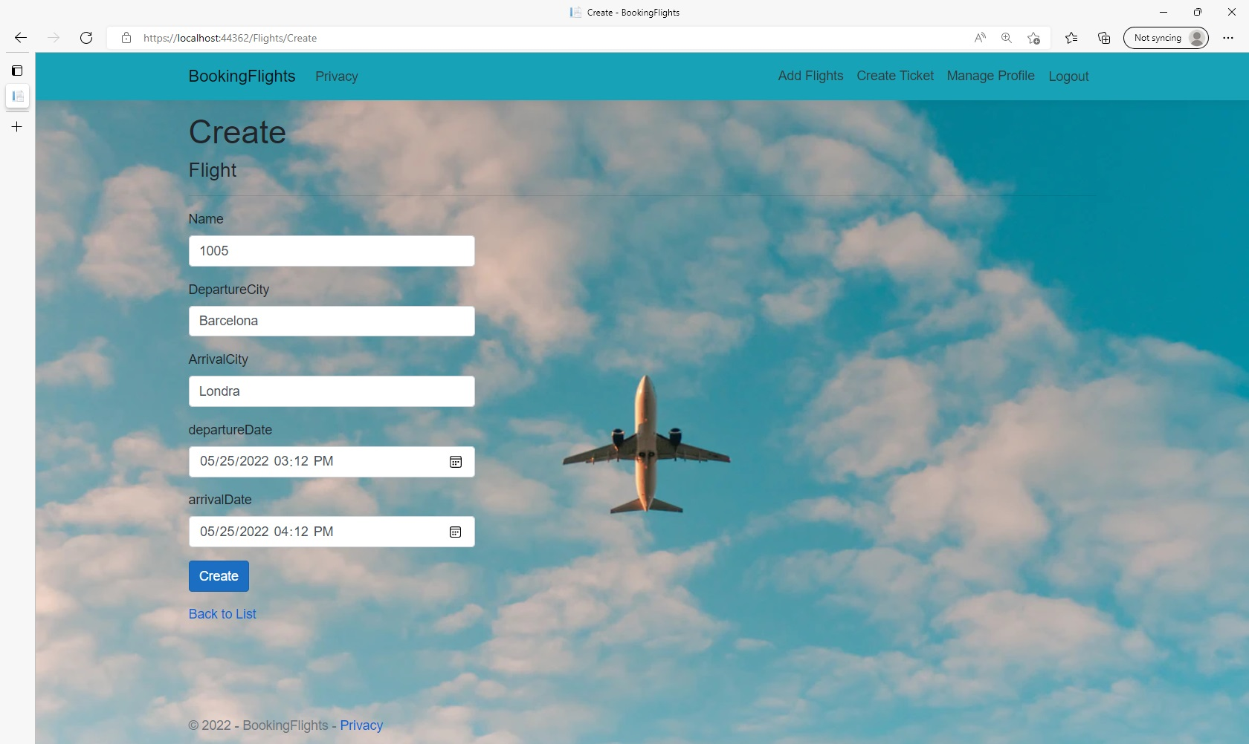
Admin can enter flight details in order to create
A new flight

Slide 16
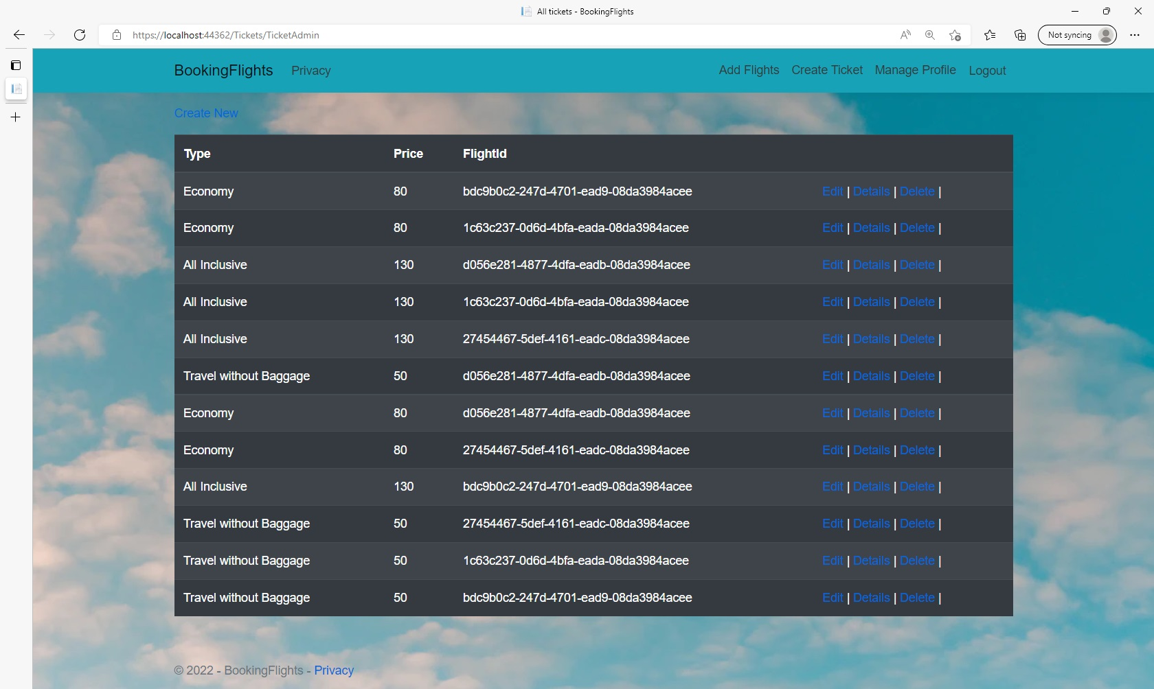
Each flight needs to have multiple tickets chosen by the admin with the respective type and price, which are based on the flight Id which only the admin has access to.

Slide 17
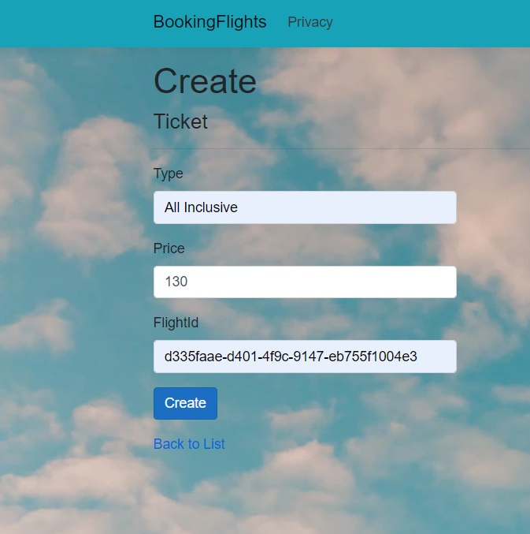
In the create ticket page the admin can choose to which Flight does the ticket belong to, based on its FlightID and assign ticket Type and Price

